Slide 1
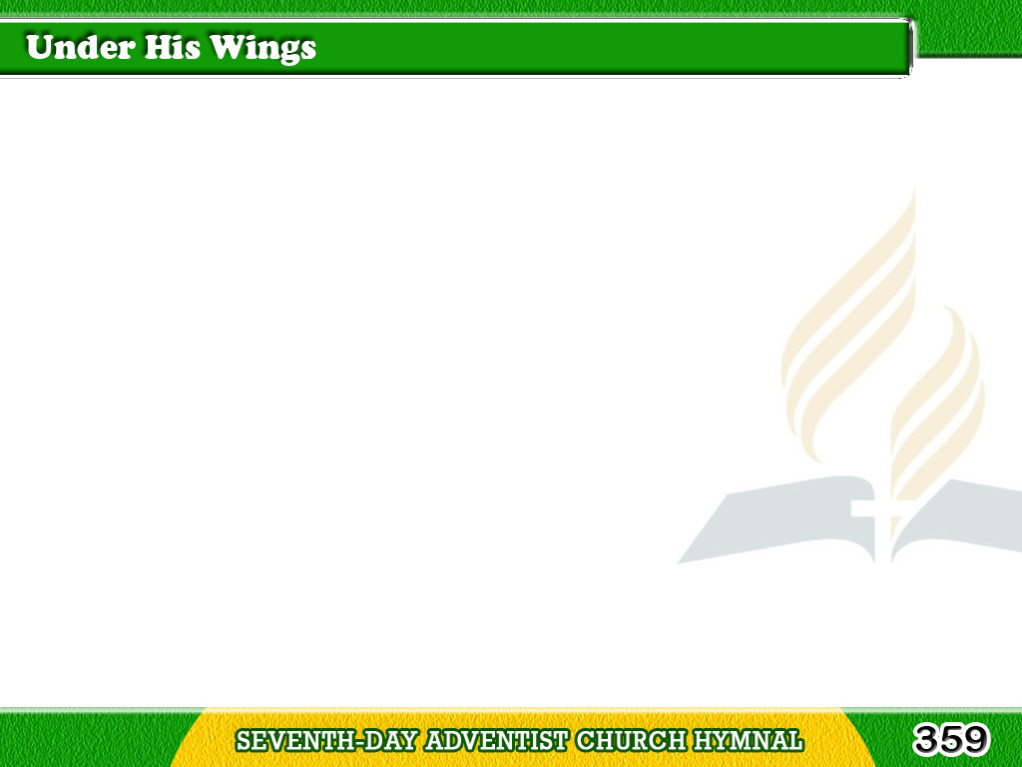
1/3
Under His wings
I am safely abiding;
Though the night deepens
and tempests are wild,
Tagalog
Version

Slide 2
1/3
Still I can trust Him;
I know He will keep me;
He has redeemed me,
and I am his child.
Tagalog
Version

Slide 3
1/3
Chorus
Under His wings,
under His wings,
Who from His love
can sever?
Tagalog
Version

Slide 4
1/3
Chorus
Under His wings
my soul shall abide,
Safely abide forever.
Tagalog
Version

Slide 5
2/3
Under His wings,
what a refuge in sorrow!
How the heart yearningly
turns to its rest!
Tagalog
Version

Slide 6
2/3
Often when earth
has no balm for my healing,
There I find comfort,
and there I am blest.
Tagalog
Version

Slide 7
2/3
Chorus
Under His wings,
under His wings,
Who from His love
can sever?
Tagalog
Version

Slide 8
2/3
Chorus
Under His wings
my soul shall abide,
Safely abide forever.
Tagalog
Version

Slide 9
3/3
Under His wings,
O what precious enjoyment!
There will I hide
till life’s trials are o’er;
Tagalog
Version

Slide 10
359
3/3
Sheltered, protected,
no evil can harm me;
Resting in Jesus
I’m safe evermore.
Tagalog
Version

Slide 11
3/3
Chorus
Under His wings,
under His wings,
Who from His love
can sever?
Tagalog
Version

Slide 12
3/3
Chorus
Under His wings
my soul shall abide,
Safely abide forever.
Tagalog
Version

